Slide 1
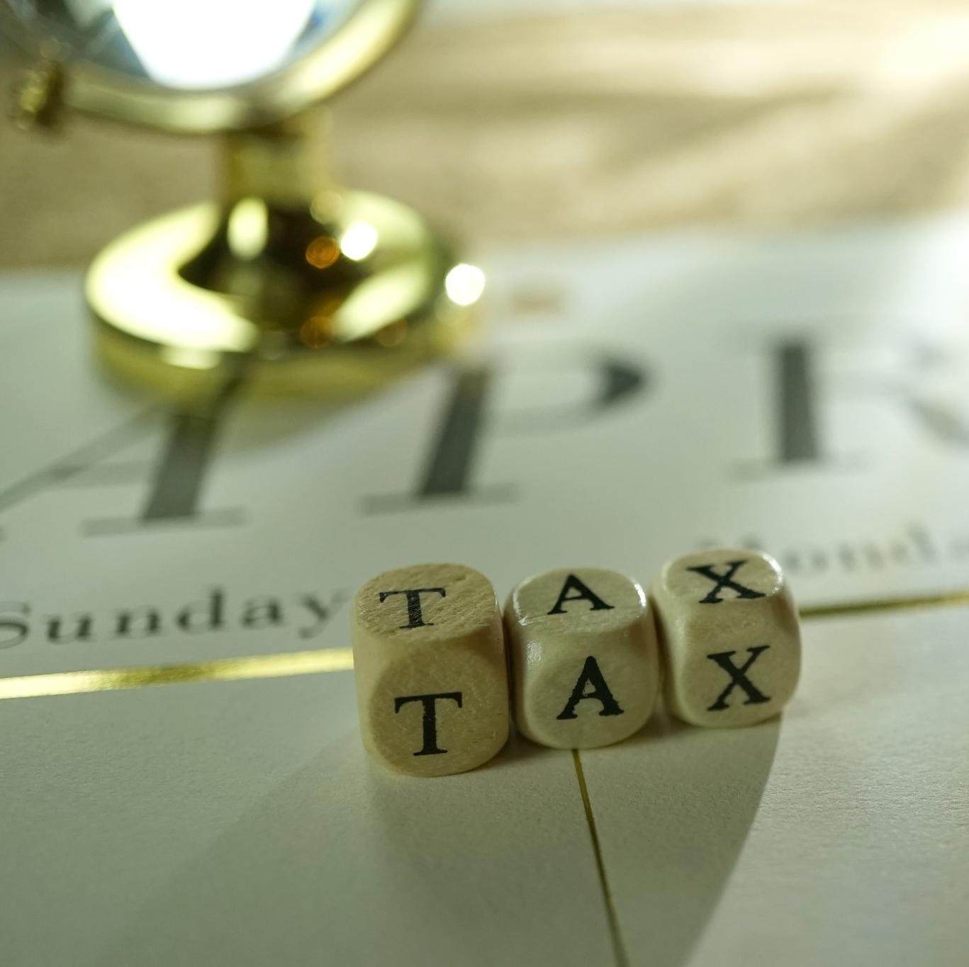
Truth in Taxation Hearing Information Session
Gun Plain Charter Township
8.6.26
Notes:
---
This presentation explores the Headlee Amendment, a significant constitutional change in Michigan that affects property taxes and local government funding. We will examine its background, mechanics, effects, key provisions, and the ongoing debates surrounding it.
Image source: Microsoft 365 content library

Slide 2
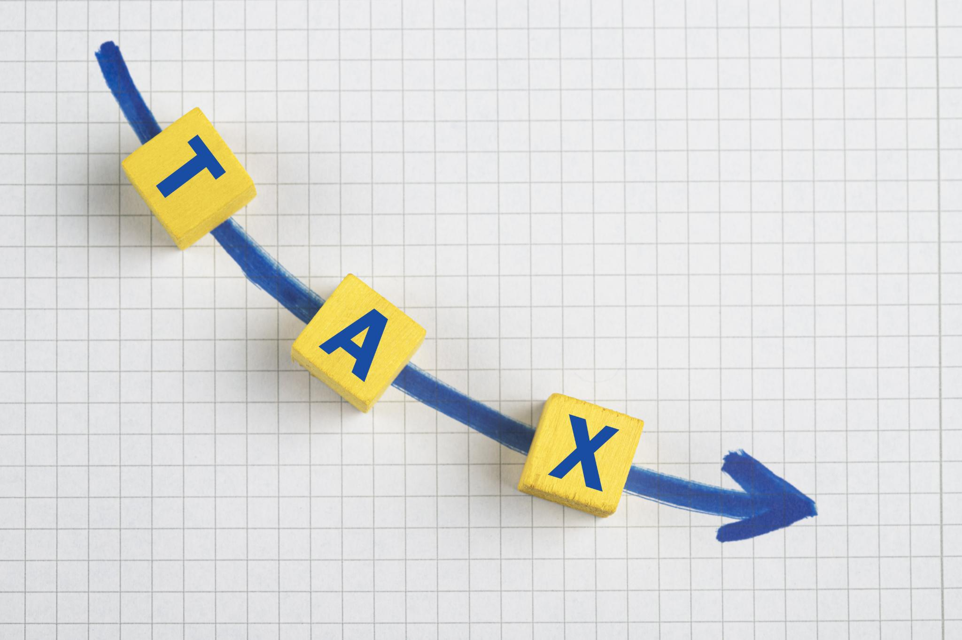
Interplay with Headlee Amendment and Truth in Taxation
Headlee Amendment (1978)
  The Headlee Amendment limits property tax increases.
  Ties tax increases to the rate of inflation
  Requires millage rates to be reduced if property values increase faster than inflation
  Truth in Taxation (1982)
  Hearing is required to discuss and approve a proposed increase in property tax revenue.
  Hearing must be in a newspaper at least six (6) days in advance and include proposed millage rate and percentage increase
Combined Effect on Tax Dollars
  Ensures tax revenues don’t outpace general rate of inflation.
  Hearings ensure local governments are accountable while allowing them to increase the tax levy and collect more revenue beyond the rolled back rate.
Notes:
---
The Headlee Amendment works alongside Proposal A and other reforms, collectively shaping Michigan’s tax landscape and influencing property tax rates and school funding.
Image source: Microsoft 365 content library

Slide 3
Each year Headlee Rollback calculations are completed for EVERY taxing jurisdiction.
This 37.50% is an increase allowed under Truth in Taxation. It’s calculated by:
1.6136 / 4.3032 = 37.50%
This is NOT a 37.50% increase in actual tax dollars, it has to do with the millages levied specifically for Gun Plain Township.
NO ONE WILL SEE A 37.50% INCREASE IN A TAX BILL AS A RESULT OF THIS HEARING
.
Notes:
---
The Headlee Amendment works alongside Proposal A and other reforms, collectively shaping Michigan’s tax landscape and influencing property tax rates and school funding.
Image source: Microsoft 365 content library

Slide 4
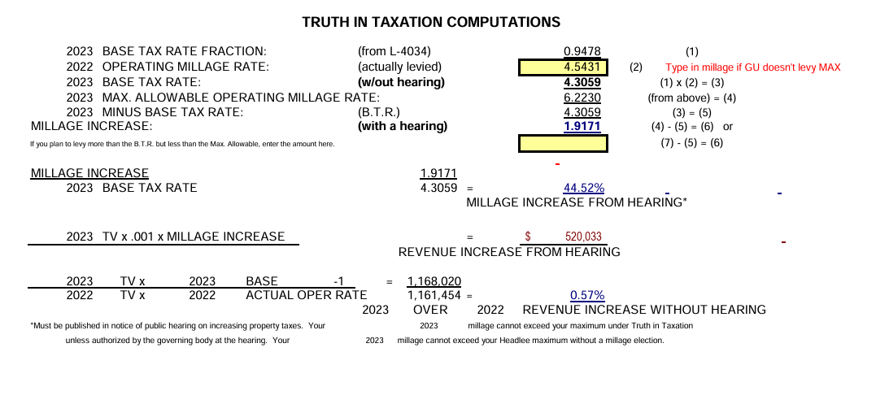
2022 - 2023

Slide 5
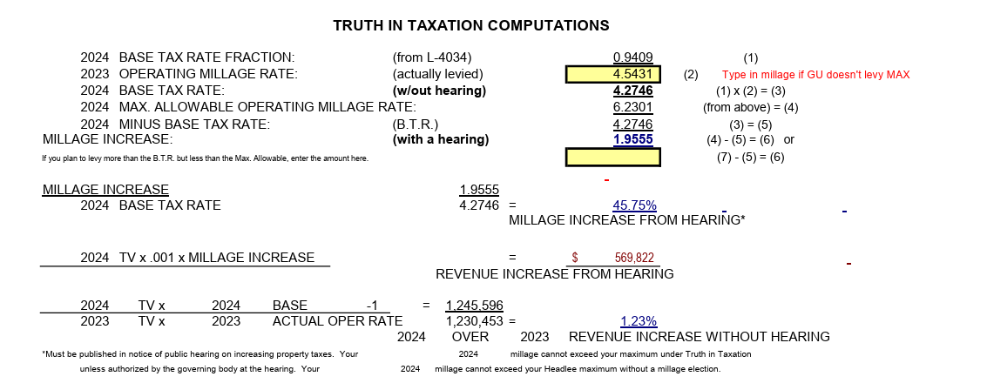
2023-2024

Slide 6
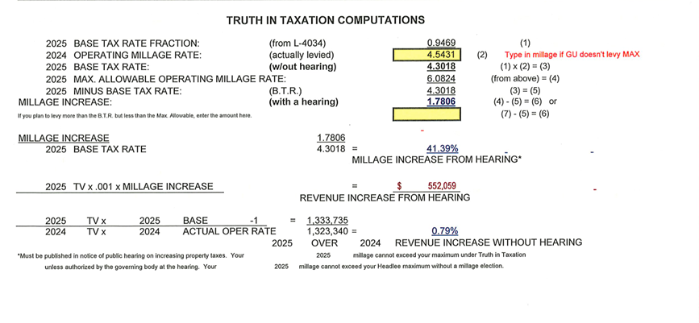
2024-2025

Slide 7
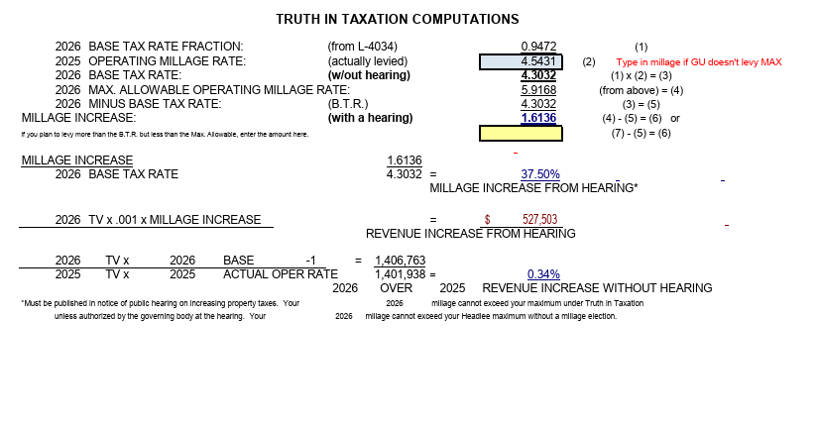
2025-2026

Slide 8

Understanding the 37.50% increase
Starting Point
2026 Reduced Millage Rates:
Allocated Operating 4.0387
Extra Voted 1.8781
Total 5.9168
Look at actual millage rates collected…
2026 Winter Tax Bill:
Township Operating Millage 1.0502
Township Road Millage 2.5000
Township Fire Millage 0.9929
Total 4.5431*
Gun Plain Township will levy less than the allowable millage rates. *Same millage rate since 2014
Notes:
---
Critics argue that revenue limits restrict local governments' ability to fund services, leading to financial challenges and calls for more flexibility.
Image source: Microsoft 365 content library

Slide 9

Why are you publishing a 37.50% increase?
Quick answer…lawyers. This hearing requires certain verbiage, and it is an increase of 37.50% in allowable millage rates specific to Gun Plain Township.
2026 Total Allowable Millage *With Truth in Taxation Hearing
6.0824 x 0.9728 = 5.9168
2026 Total Allowable Millage *Without Truth in Taxation Hearing
4.5431 x 0.9472 = 4.3032
5.9168 – 4.3032 = 1.6136
Proposed Increase in Millage Rates (Gun Plain Township ONLY):
1.6136 / 4.3032 = 37.50%
Notes:
---
Critics argue that revenue limits restrict local governments' ability to fund services, leading to financial challenges and calls for more flexibility.
Image source: Microsoft 365 content library

Slide 10

Gun Plain Township is proposing a millage rate for 2026 winter bills of 4.5431, not the allowable 5.9168 with truth in taxation.
Bottom line. What does all of this mean for a tax bill:
2025 Taxable Value 2025 Millage Rate Taxes Paid GPT Millages
$100,000 4.5431 $454.31
Taxable Value increased 2.7% for 2026 with rate of inflation set by State of Michigan. *exclusions apply
$100,000 x CPI (2.7%) = $102,700 sets 2026 Taxable Value
2026 Taxable Value 2026 Millage Rate Taxes Paid GPT Millages
$102,700 4.5431 $466.57
Increase in a tax bill would be $12.26 with the proposed 37.50% increase with Hearing
Notes:
---
Critics argue that revenue limits restrict local governments' ability to fund services, leading to financial challenges and calls for more flexibility.
Image source: Microsoft 365 content library

Slide 11

If Gun Plain Township isn’t even increasing their millage rates, why are we holding a hearing?
If the FULL headlee rollback were to be incorporated the millage rate would fall to 4.3032. To levy the same millage rate that has been levied since 2014, we are required to hold this hearing...
Recap…
Property Taxes should be less confusing, no question, but remember that we are here to help, not hinder the process.
Gun Plain Township is serious in its stewardship of tax dollars collected and operates with a lower millage rate than what it potentially could collect
The increase is a change in an allowable millage rate and not a change in the amount of money you pay
Notes:
---
The Headlee Amendment works alongside Proposal A and other reforms, collectively shaping Michigan’s tax landscape and influencing property tax rates and school funding.
Image source: Microsoft 365 content library

